Slide 1
Milestone III
Nick Hawkins
Bennett Roach
Victoria Olson-Orton

Slide 2
Outline
Group Roles
Feedback
UX/UI - Site/Page Layout
Technologies Used

Slide 3
God’s Word For Warriors

Slide 4
Analysis
GWFW: Non-Profit organization for aiding in spiritual healing for veterans
Visitors: Veterans and Supporters
Market: Wounded Warrior Project, Semper Fi Fund, Operation Homefront
Funding: Funded entirely by small dollar donations and churches

Slide 5
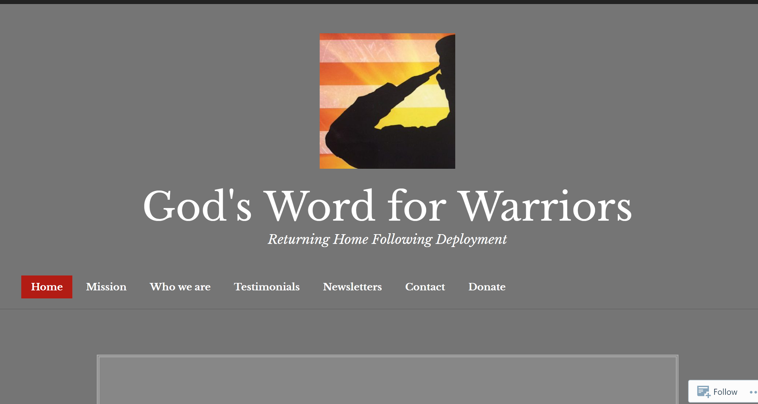
Current Site Layout
Home page material not appropriate for website goals
Mission - should be in Home page
Testimonials - Better off referenced throughout site
Newsletters
Nav Section not positioned well

Slide 6


Slide 7
Problems w/ Current Site ----> Solutions
Content is cluttered and scattered.
Site layout is confusing.
Lacking logo, presentable theme, and graphic content
Reorganize all content under new tabs
straight-forward and simplified minimalistic layout
Logo & theme proposals consistent with brand + image cache

Slide 8
Group Roles

Slide 9
Web App Dev Team - GWFW
Nick Hawkins - About Us / Events
Bennett Roach - Home / Donate
Victoria Olson Orton - Contact Us / Newsletters

Slide 10
Proposed UX/UI

Slide 11
Proposed Site Layout
Key:
Black = w/in scope of semester
<Highlighted> = User Story (What it gives the user/admin/donor/etc)
Green = if feasible, later

Slide 12
Home:
Site Name (Home)
Mission Statement - banner background (video would be nice)
Donate - Action Button <user directed to donation page> (future element)
(Most Recent) Newsletter - 1st of 3 boxes under banner. Link to Newsletters
(Rotating) Testimonial(s)
Find GWFW Near You
Events <list of upcoming events w/ applicable links> (from automated calendar)
Bring GWFW to Your Community <Contact Us>
Testimonials - selected testimonials w/ “read more” link to full page
How can I help?
Donate
etc...

Slide 13
About Us:
About Us
Seals’ Story - summary w/ “read more” goes to new page w/ full story
Members - all summarized w/ “read more”s to new pages w/ full info
Board
Leadership
Become a Member (careers)
Sponsors/Biggest Donors

Slide 14
Etc.
Events <list of upcoming events> (from automated calendar)
Newsletters <User can access admin-posted newsletters> (emailed to automated list)
Future elements Most recent? Recent 3? ...in box each w/ read more link to full page
Future elements List w/ pic, title, summary, date, author, etc each w/ link to full page
Contact Us <User given relevant contact options & accompanying info> (plugin here?)
Contact Us <form that user fills out to relay their questions>
Donate <form that user fills out to submit donations online>

Slide 15
Developing Website Layout:

Slide 16
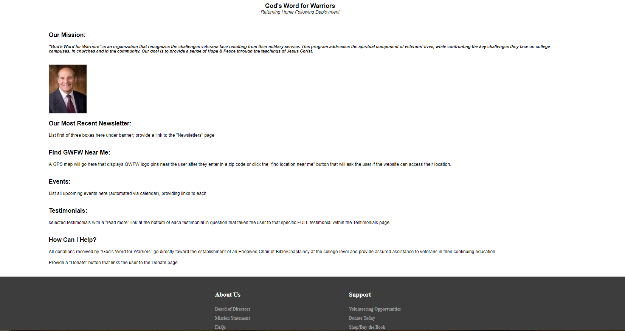
Home:

Slide 17
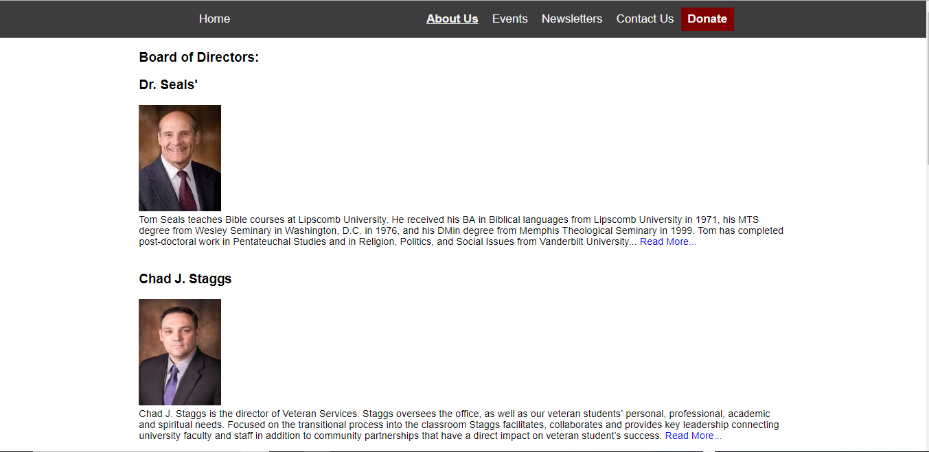
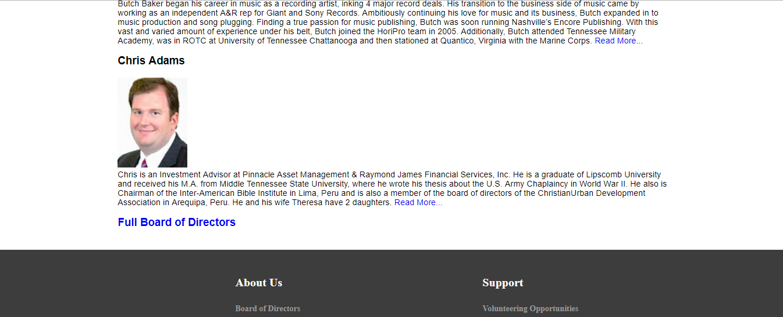
About Us:

Slide 18
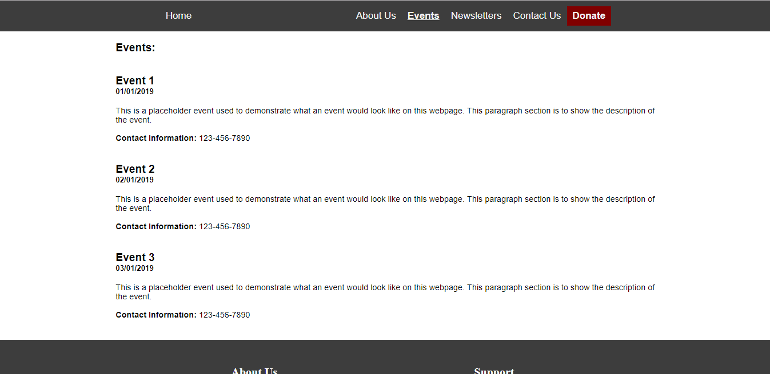
Events:

Slide 19
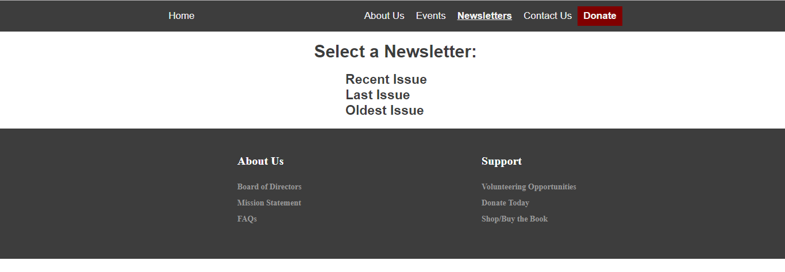
Newsletters:

Slide 20
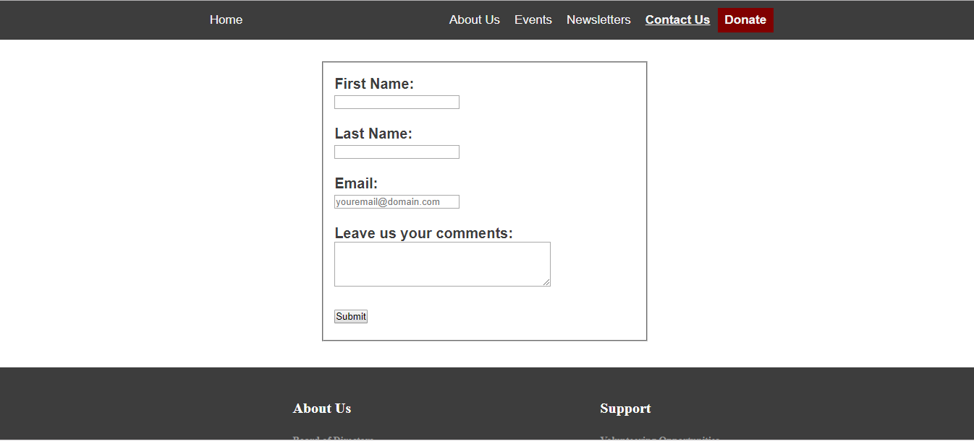
Contact Us:

Slide 21
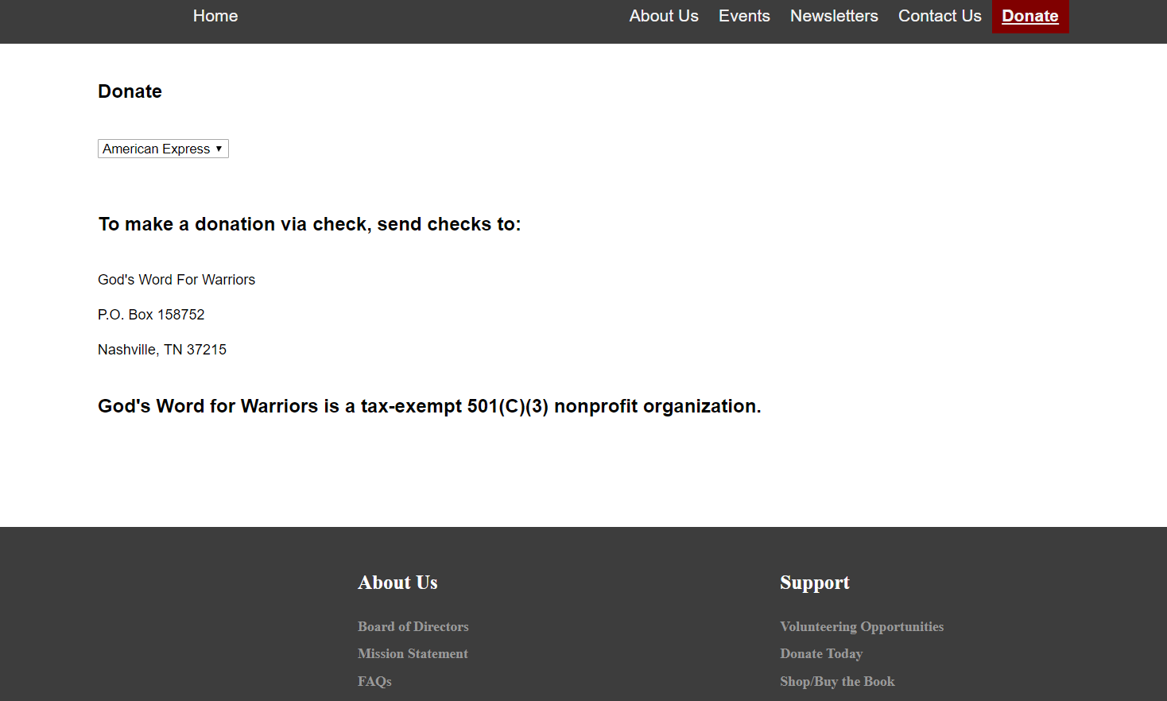
Donate:

Slide 22
Tech

Slide 23






Technologies
WP - Planned for Expansion
Calendar - Meeting Reminders
Drive - Documentation
Hangouts - (some) Meetings
Trello - Task Mgmt
Slack - Communication

Slide 24
Fin

